Slide 1
Traffic Simulator
Hunter Negron

Slide 2
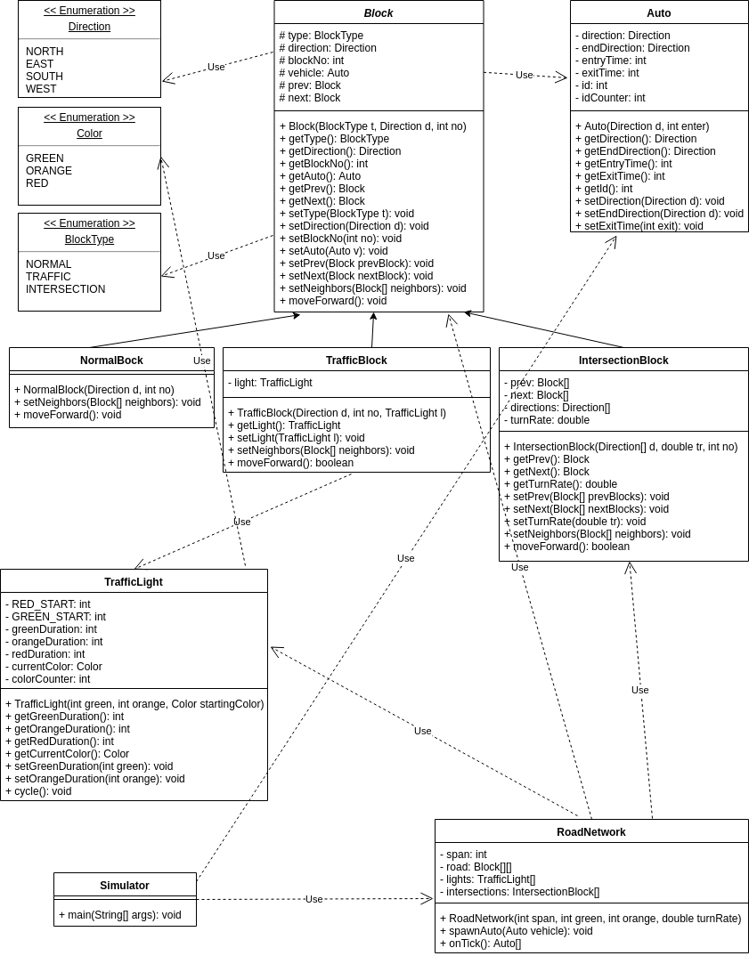
UML

Slide 3
Design Breakdown: Blocks
Abstract Block class
Inherited by NormalBlock, TrafficBlock, and IntersectionBlock
Utilizes the BlockType and Direction enums
Attributes
blockNo
Vehicle
Prev & next
Abstract methods
setNeighbors(Block[] neighbors)
moveFoward()

Slide 4
Design Breakdown: Traffic Management
TrafficBlock class
Like a normal block, but has a TrafficLight
TrafficLight class
Utilizes the Color enum
Initialized with green and orange durations
Computes red duration
cycle() method systematically changes the light color on each tick

Slide 5
Design Breakdown: Intersections
IntersectionBlock class
Initialized with turn rate
Has multiple directions, prev Blocks, and next Blocks
The moveForward() method
Generates a random number 0 - 1
If less than the turn rate, changes the vehicle’s direction and advances it
If not, then advances it in the current direction

Slide 6
Design Breakdown: Vehicles
Auto class
Start Direction
End Direction
Entry time
Exit Time
References are contained in an ArrayList in the Simulator

Slide 7
Design Breakdown: RoadNetwork & Simulator
RoadNetwork Class
Utilizes all other classes to construct an intersection
onTick() method updates TrafficLights, moves cars forward, and return exited cars
spawnCar() is used by Simulator to add new cars
Simulator
Collects information from user
Runs through each tick, randomly adding new cars
Calculates data and outputs it where necessary

Slide 8
Test Case Format
The Simulator accepts 6 inputs
Entry Rate: real number between 0 and 1
Turn Rate: real number between 0 and 1
Green: nonnegative integer
Orange: nonnegative integer
Simulation Time: nonnegative integer
Lane Span: positive integer

Slide 9
Test Case #1
Test poorly formatted numbers
Input “n”
Output “Not a valid number. Exiting.”

Slide 10
Test Case #2
Test out-of-range numbers
Input “-1”, “-1”, “-1”, “-1”, “-1”, “0”
Output “All values must be nonnegative. Span must be positive. Exiting.”
Span must be a positive number in order to have traffic lights to control.

Slide 11
Test Case #3
Test the minimum allowed numbers
Input “0”, “0”, “0”, “0”, “0”, “1”
Output
Average Wait Time: 0.0
NORTH-bound flow rate: 0
EAST-bound flow rate: 0
SOUTH-bound flow rate: 0
WEST-bound flow rate: 0
Total Flow Rate: 0

Slide 12
Test Case #4
Test generic numbers
Input “.4”, “.6”, “8”, “2”, “500”, “6”
Output
Average Wait Time: 17.64786324786325 NORTH-bound flow rate: 115 EAST-bound flow rate: 185 SOUTH-bound flow rate: 121 WEST-bound flow rate: 164 Total Flow Rate: 585

